Slide 1
Takornariaqarnermi tamanut naleqqussakkamik ilusilersuineq
Tiliup tamanut naleqqussakkamik ilusilersuineq pillugu 2024-mi ataatsimeersuartitsinera
Kalle Ristikartano

Slide 2
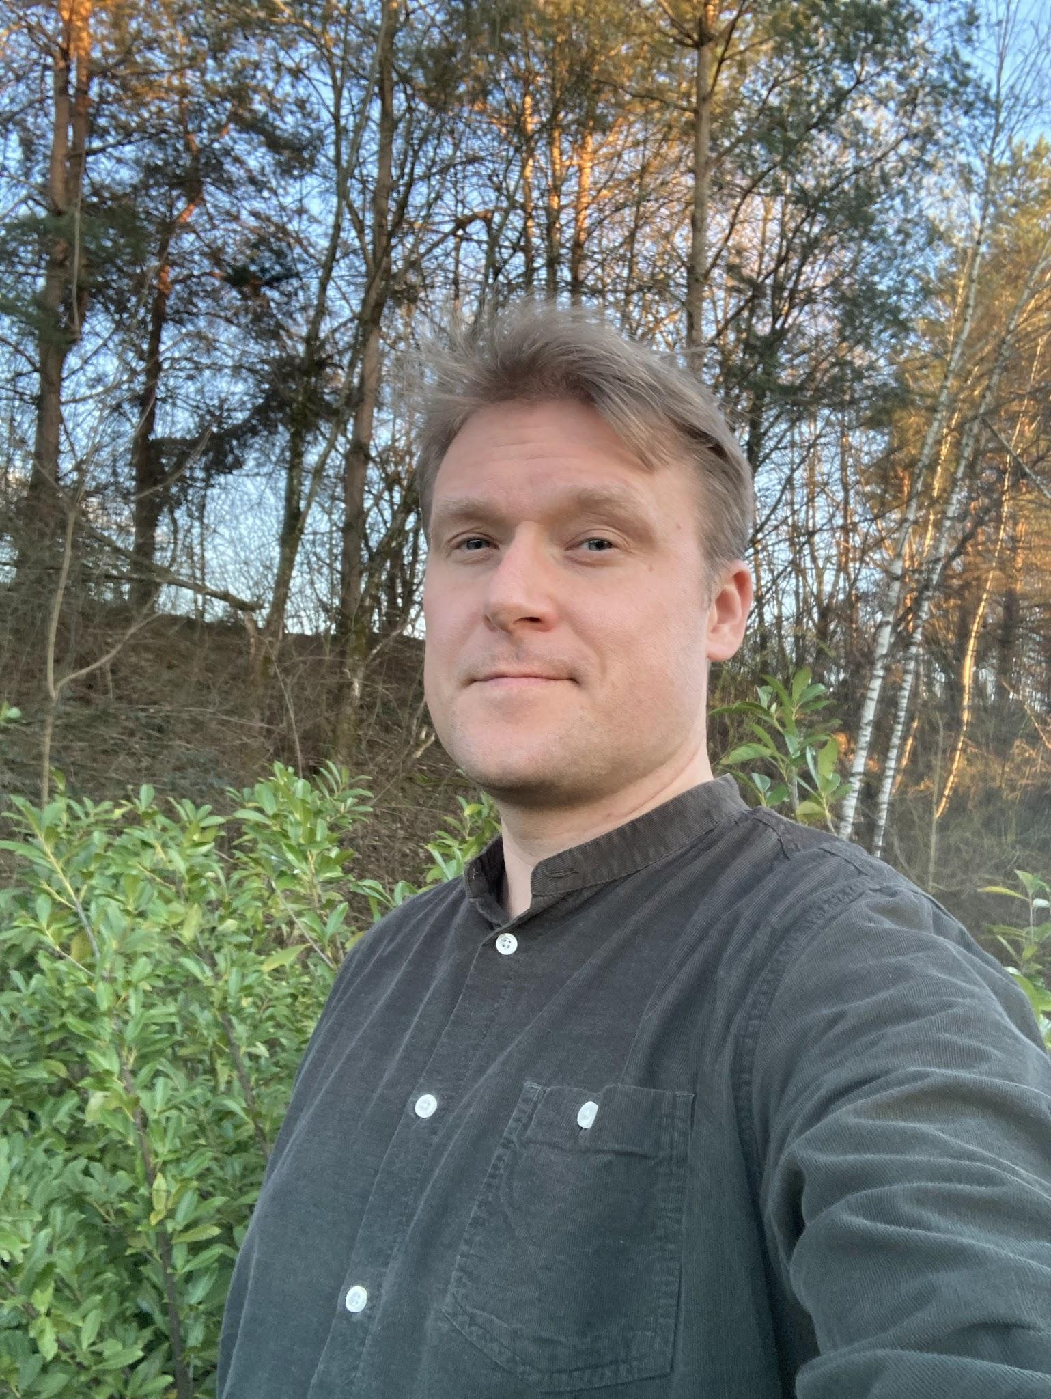
Uanga pillunga
Ukiuni 22-ni akuutitsiniarnermi aamma assigiinngissutsinik suliaqarnikioq
Pisortanut, namminersortunut peqatigiiffinnullu 36-nut sullissinikoq
Timikkut, malugisaatikkut paasinnittaasikkullu innarluutillit, inuit sianiutimikkut allaassutillit aamma ilikkarniarnerminnik ajornartorsiutillit pillugu ilusilersuisoq naleqqussakkammillu suliniutinik ingerlatsinikoq.
Notes:
Keeping it short - basically just saying out aloud things on the slide

Slide 3
Takornariaqarnermi tamanut naleqqussakkamik ilusilersuineq
Kikkunnut tamanut ilusilersuineq pillugu neqeroorneq
Notes:
My presentation aims to explore the possibilities of tourism services designed for all
Universal design has already been described over the conference
I trust participants from the tourism sector to know their work. I will just showcase what has been done and learned elsewhere

Slide 4


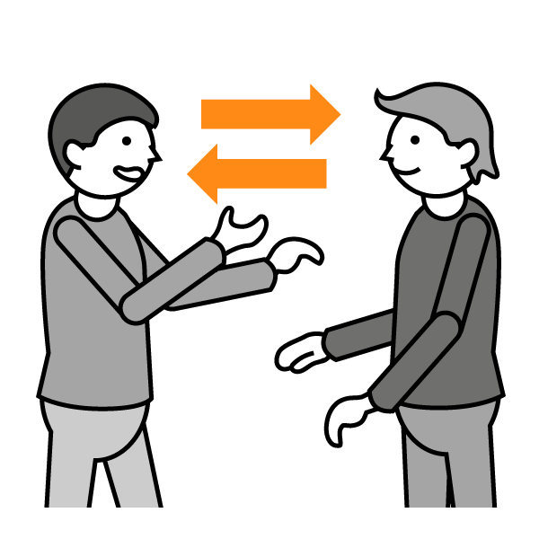


Naalisaaneq: ilusilersuinermut neqerooruteqannginnermi misissortariaqakkat
Tappiitsut isigiarsuttulluunniit
Tutsarluttut tusilartulluunniit
Tikikkuminassuseq
Attaveqarniarnermi ajornartorsiutit
Neurodiversitet
Copyright: Papunet / Sclera, Wikipedia / CC by-as 4.0 Deed / E mln e & CC0 1.0 DEED / Mrmw
Notes:
Also these have been already discussed in other presentations. But I will use these 5 categories to explore tourism for all.
Shortly naming the things on the slide and telling more about them:
First two are about sensory disabilities related to vision and hearing. Other senses can also be disabled that can alter people’s participation, for example lack of sense of touch easily leads to accidents.
Physical accessibility is usually the most well known
Communication challenges can be due to multiple reasons, physical inability to form the sounds or challenges in understanding just to name two
Under neurodiversity I put wide range of things that are often dealt separately, but I ran out of space… Here are for example autism spectrum, learning difficulties, ADHD, Tourette, intellectual disability
In the field of inclusion and diversity there are plenty of other issues like cultural customs, gender and sexual identity issues, people breaking social norms etc. but in this presentation I will concentrate more to barriers caused by disability.

Slide 5
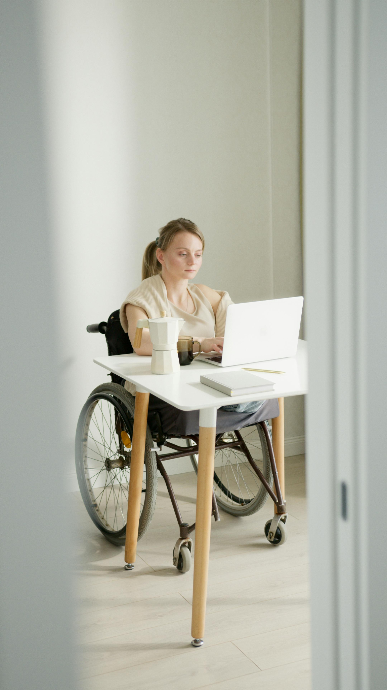
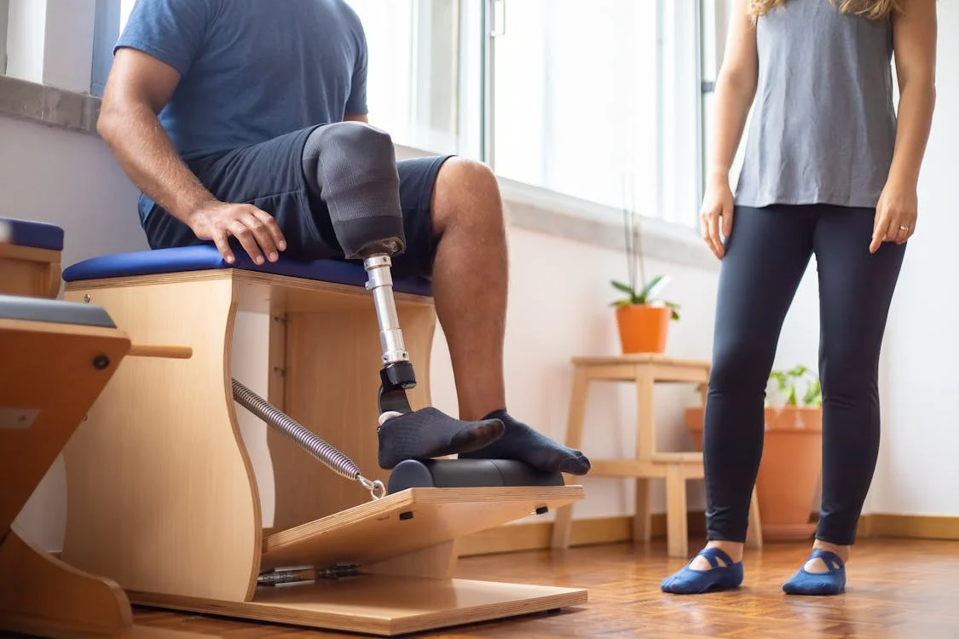
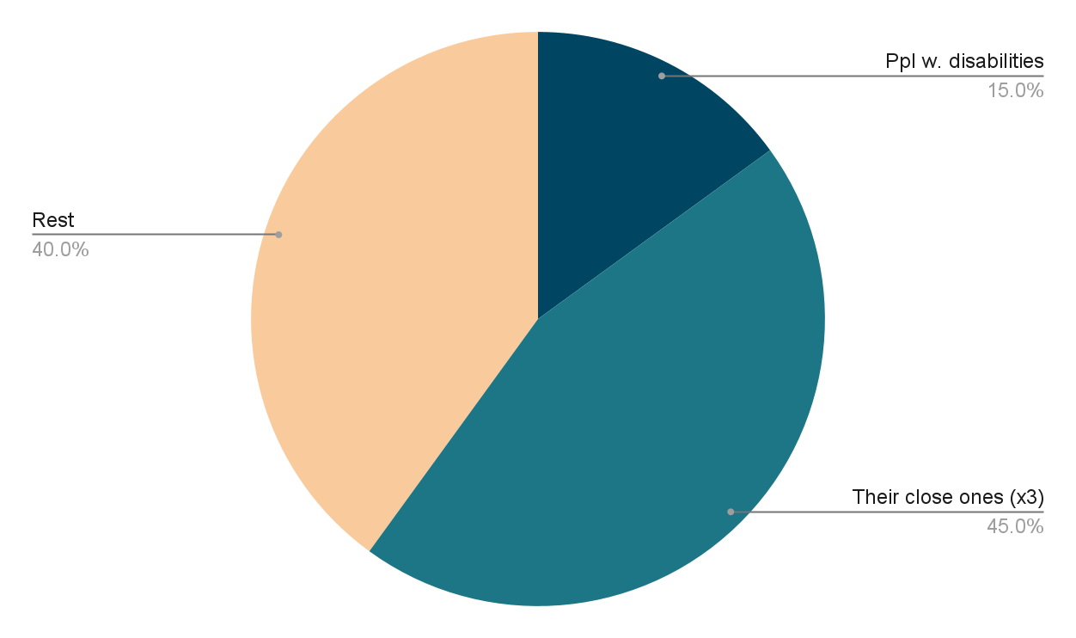
Sooq akimmiffiit piiassavagut? - Pisisartut atorluarneqanngitsut
Inuit innarluutillit nunarsuarmi innuttaasunit 15 %-iupput (ikinngutitik ilaquttatillu peqatigalugit tikeraarnermi tikikkuminassuseq pingaaruteqarpoq)
Inuit innarluutillit aningaasaateqarput amerlanernillu aningaasaateqarlutik aggertarput.
UN: https://www.un.org/en/content/disabilitystrategy/
https://www.bestcolleges.com/research/students-with-disabilities-higher-education-statistics/
Notes:
Left side:
Even just 15 % of the population makes a significant target group, but…
Over 25 % US households has a member with disability (https://www.census.gov/content/dam/Census/newsroom/press-kits/2023/paa/2023-paa-poster-demographic-disability-family.pdf)
…and that doesn’t count in the parents of adults with disabilities, friends etc. that might be looking for places to travel with their disabled close one.
Inclusive tourist services are still hard to find, so there’s a clear gap to fill.
Right side:
I personally know lawyer, university researcher, psychotherapist, Europarliamentarist and several other high paid professionals with disabilities
In USA almost 20 % of 25-34 years old with disability have a bachelor's degree or higher and 95 % were employed.
Even wider groups of people with disabilities participate trips organized by disability organizations
There is also money in services like rehabilitation for people with disabilities (paid for example by insurance)

Slide 6
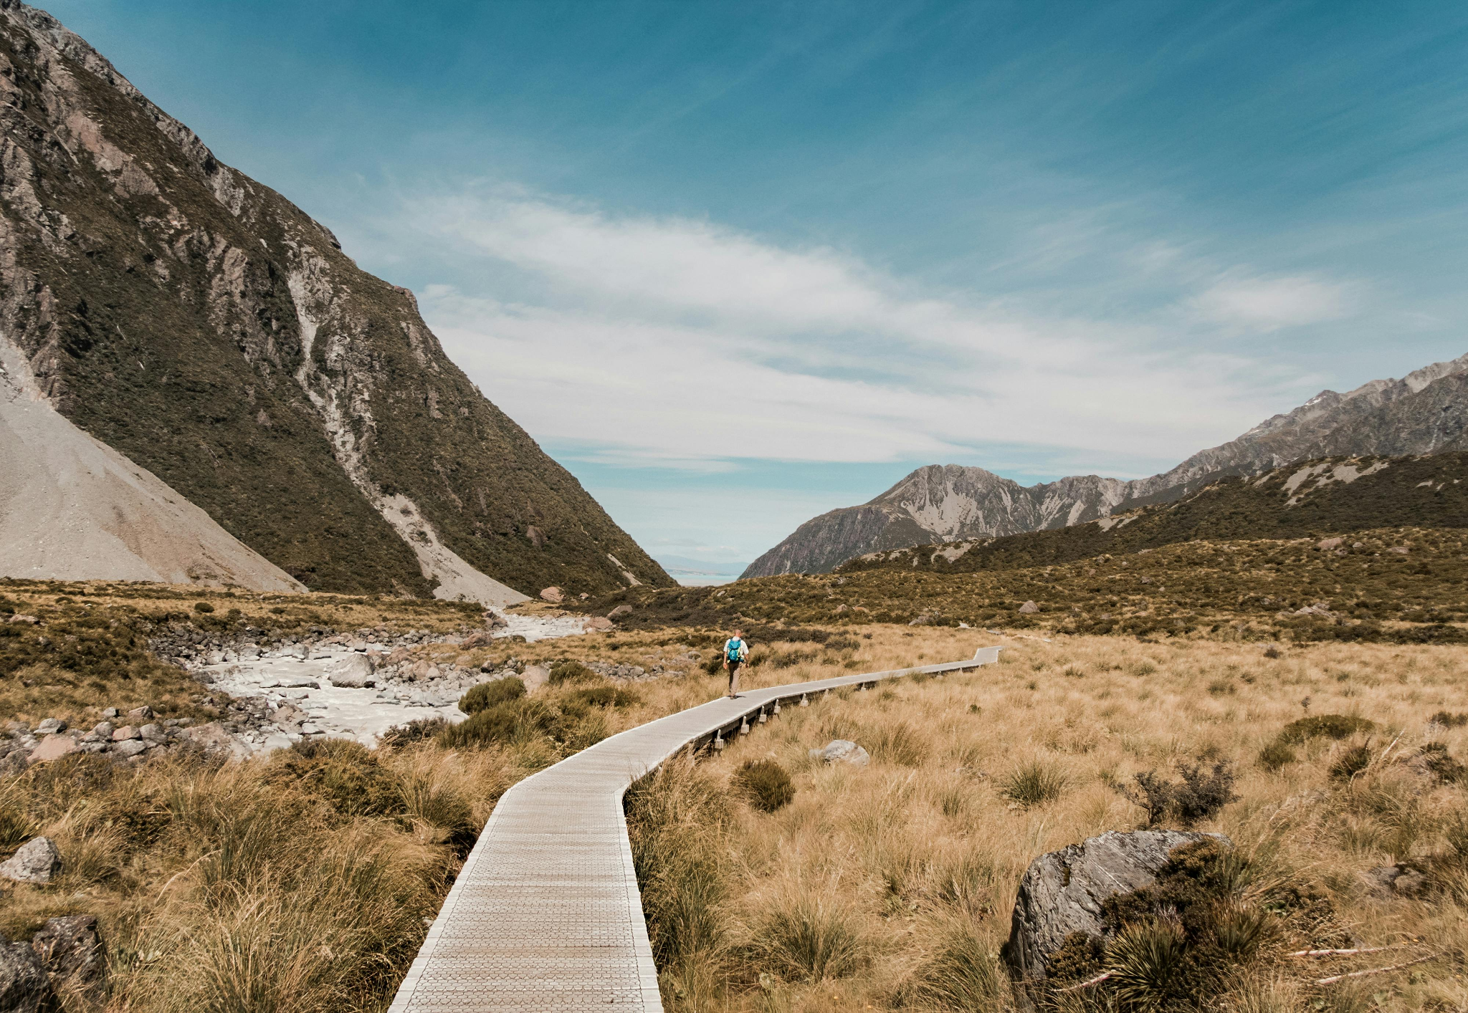
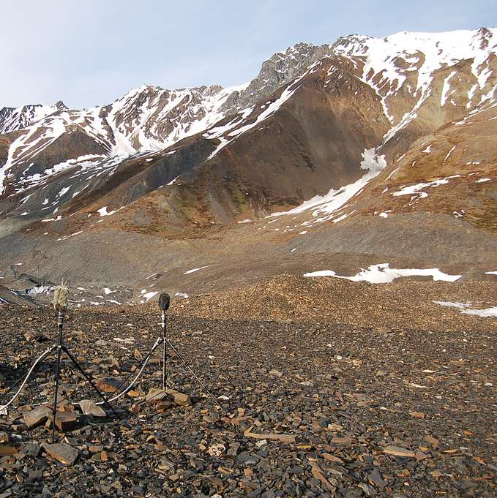
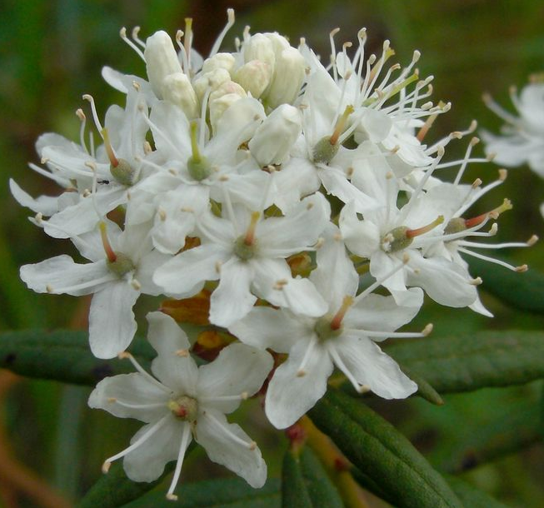
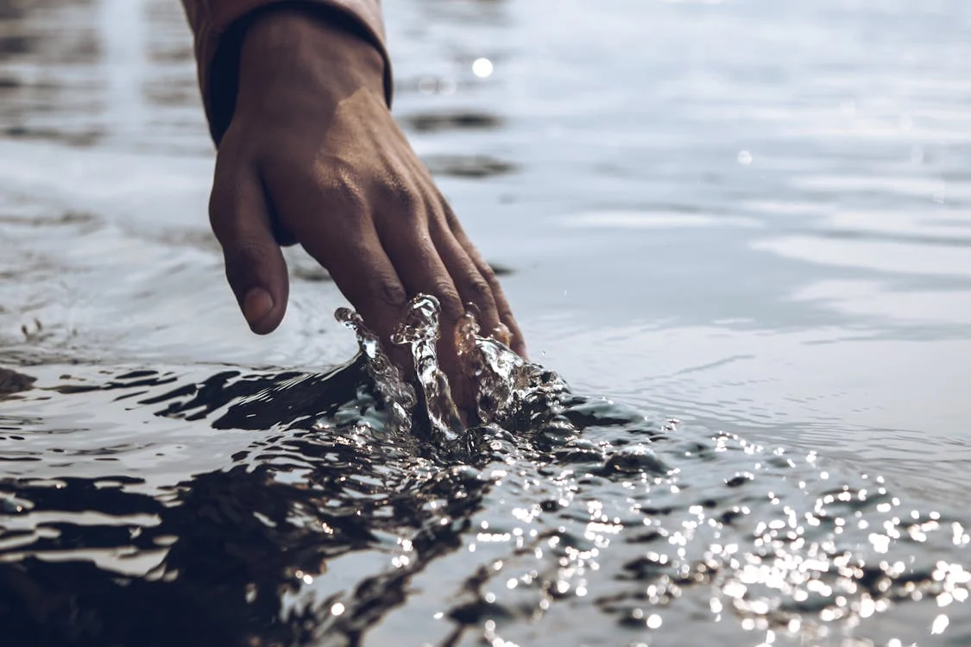
Sooq akimmiffiit piiassavagut? – kikkunnut tamanut neqeroorut pitsaaneq
Inunnut innarluutilinnut ilusilersuinermi neqerooruteqartoqaraangat, tamanna kikkunnut tamanut tikikkuminartuussaaq
… aamma inuit innarluutillit pillugit ilusilersuisoqaraangat kikkunnut tamanut nuannersumik misigititsisoqarsinnaavoq
Jason Hollinger
Notes:
Left side:
More or less all of the adjustments that might be needed will serve others too
Just the boardwalk on the picture makes the route available for parents with strollers, for older people with bad legs…
Other examples will be presented later
Right side:
Design of soundscapes, touch experiences, fun new tools etc.
Innovation often comes from necessity to think things from different angle - how can I create an experience in magnificent landscape for a person that can’t see?
But of course once new experience has been created, it can be offered also for people with working eyes

Slide 7
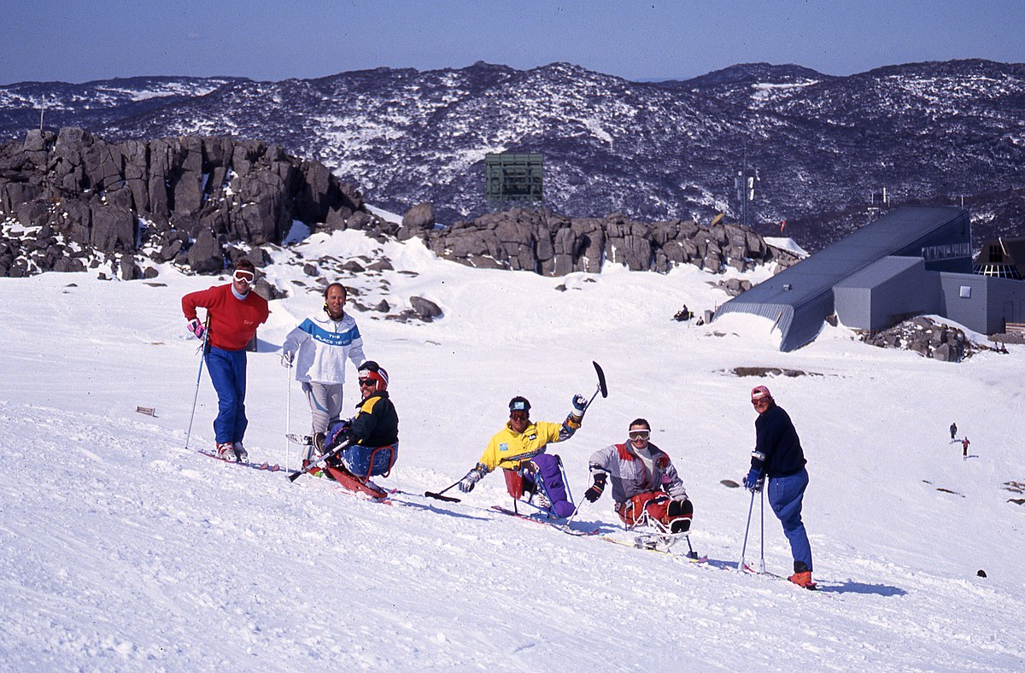
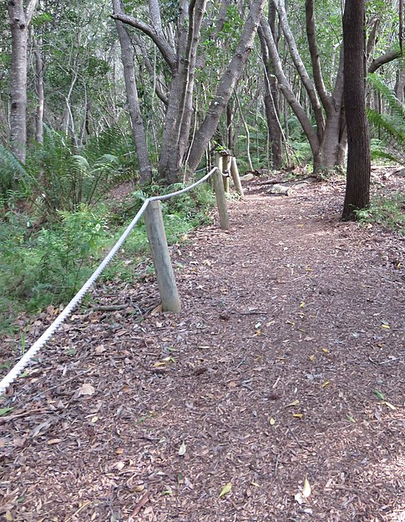
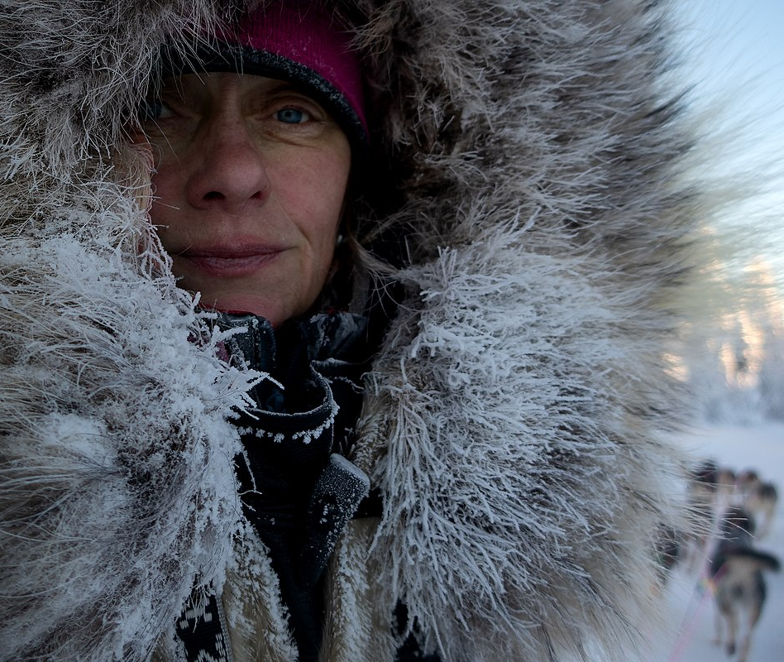
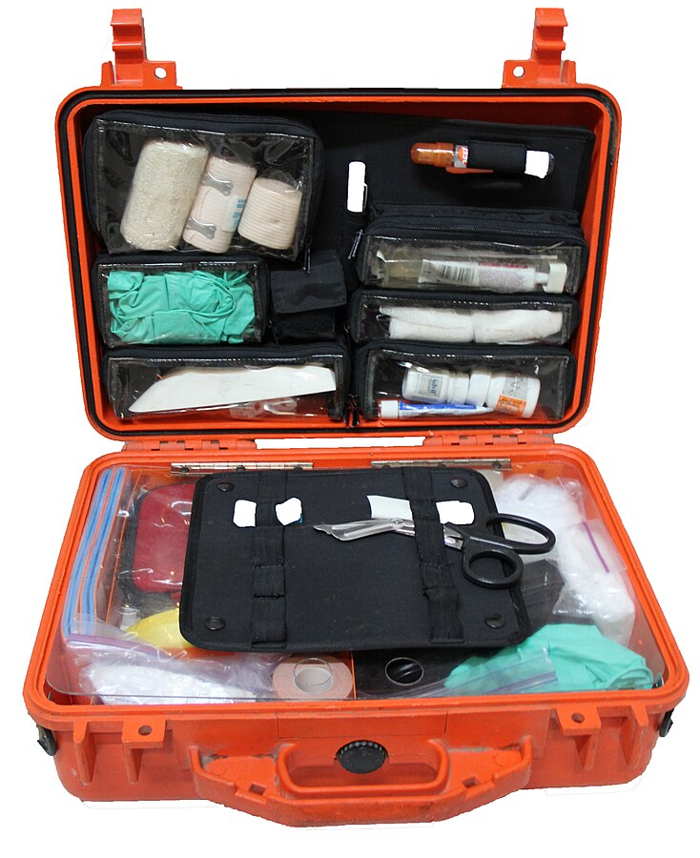
Sooq akimmiffiit piiassavagut? – isumannaassuseq aamma isigineqarneq pitsaaneq
Inunnut innarluutilinnut akuutitsinerunissamut ilusilersuineq ulorianartuusinnaasut ersarinnerulertarput, taamaalillunilu kikkunnut tamanut isumannaassuseq toqqissisimanerlu pilersinneqartarluni
Neqeroorutissi tunngavigalugu inuit innarluutillit nuannaarutigippassuk, taava aamma ilissi takutittarparsi soqutiginnittuullusi kikkunnullu tamanut neqerooruteqarumasuususi.
Wikimedia Commons: ~riley; Jana Henychová; Australian Paralympic Committee CC BY-SA 3.0 DEED, Antony-22 CC BY-SA 4.0 DEED
Notes:
Left side:
Be it thinking ways to keep immobile people warm, how to safeguard trip to person depending on extra oxygen to building routes that are safe to walk also for blind…
…Anything similar can happen to any other customer, too: people get cold, have an medical emergency, stumble or get caught by dark
Right side:

Slide 8
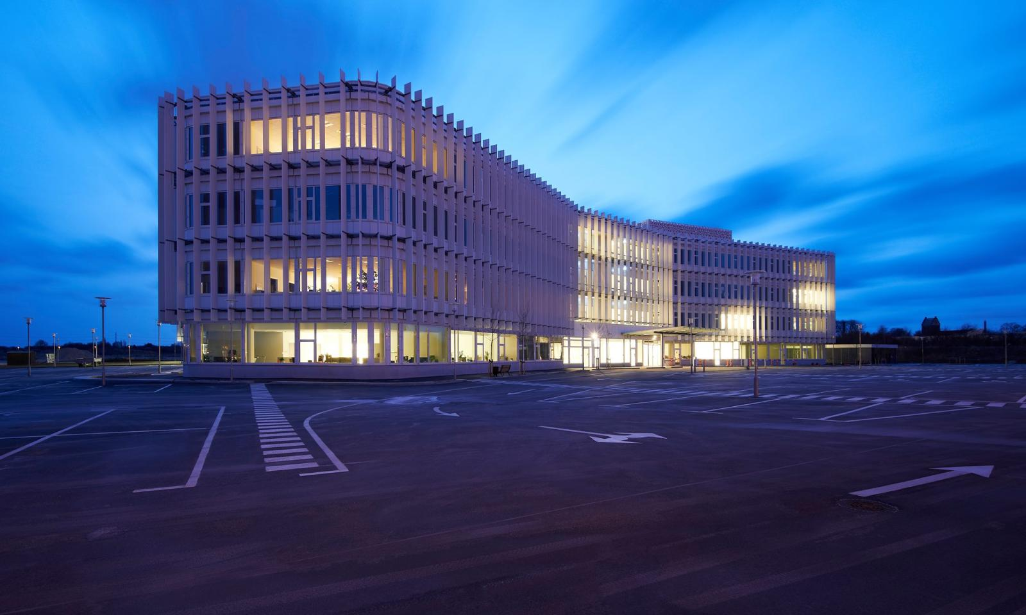
Sooq akimmiffiit piiaassavagut? – Aningaasartuutit akisussaaffillu
Uppernarsarneqarnikuuvoq sanaartukkat nutaat tikikkuminarsakkat akisunerunngitsut–Handicaporganisationers hus DK-miittoq assersuutaalluarpoq:
Inuiaqatigiinni tamanna aamma atuutsinneqaraluttuinnarpoq
Americans with Disabilities Act 1990
United Nations Convention on the Rights of Persons with Disabilities 2008
European Accessibility Act: EU directive 2019/882
ISO 21902:2021 - Accessible Tourism for All
Og mange flere love og reguleringer
https://handicap.dk/about/the-worlds-most-accessible-house
Notes:
Left side:
Danish house of disability organisations has a lot of design features making the house accessible, still costing the same than similar office building built without the adjustments
Many barriers of inclusion and accessibility mainly require change of thinking, for example learning to guide a blind person on a trail path
Some things do cost, but like said earlier, many of the adjustments pay themselves back by serving all of your customers and making your service better, more innovative and safe
Right side:
Usually it is better to be one of the first ones to lead the way, than be one of the lasts to be forced to make the changes

Slide 9
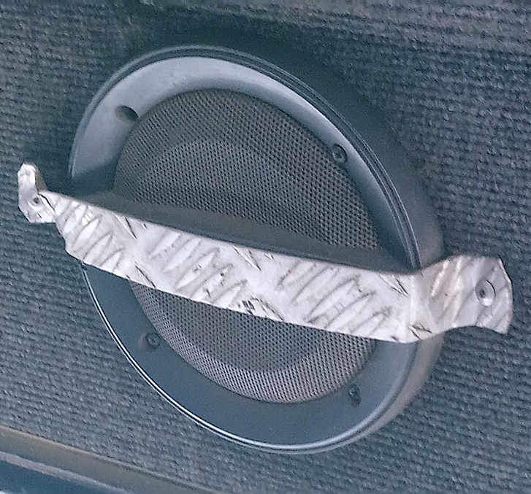
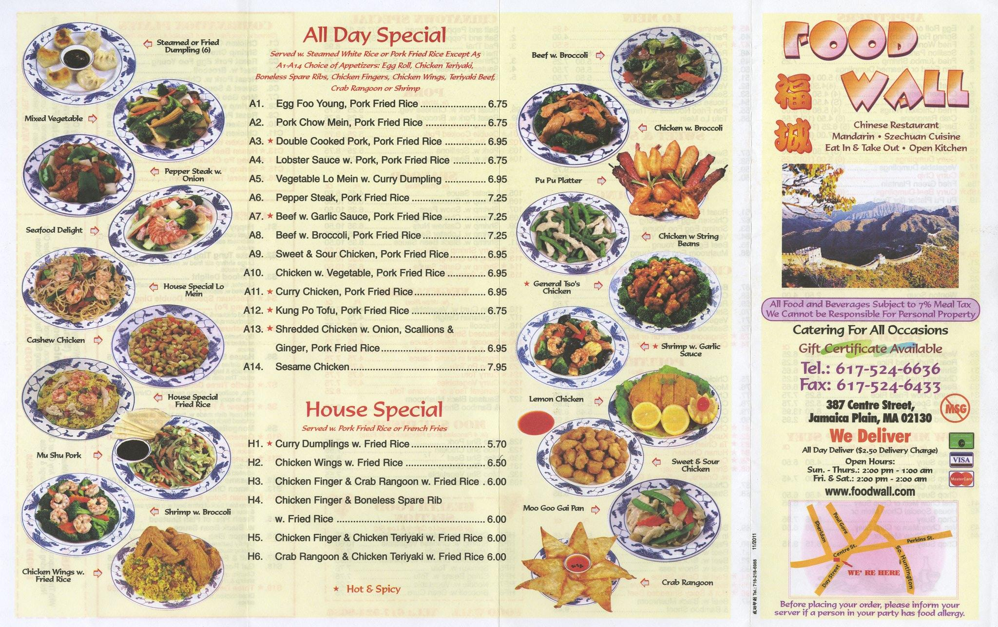

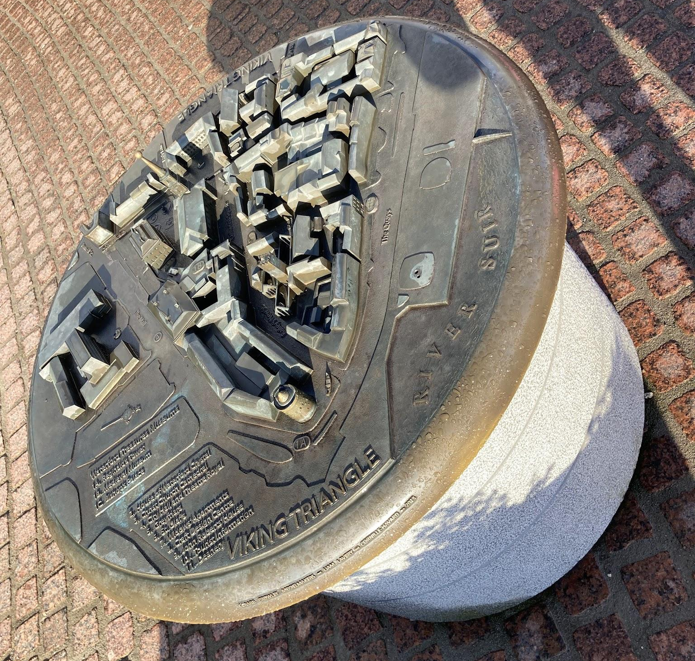

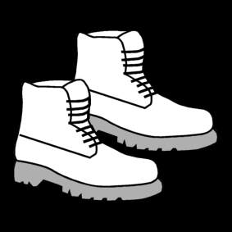
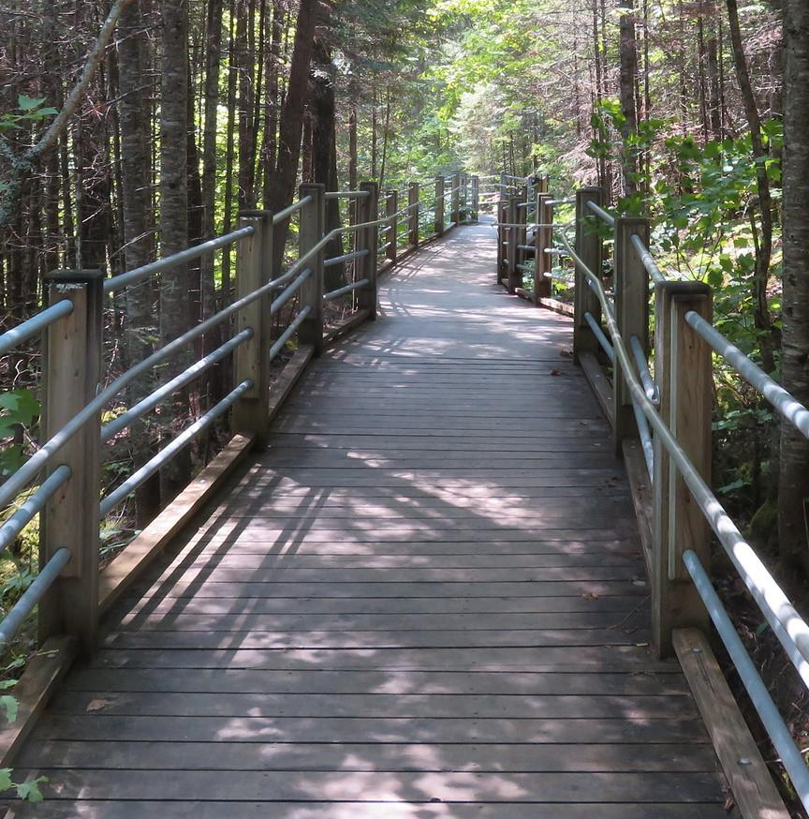
Aaqqiissutissat ilaat
W3C WAI
Papunet: Sclera, Planet Takeout, Inclusion Europe, Sean Marshall, Carl Holderness CC BY 4.0 DEED
Notes:
From left to right:
Offering audio-guidance helps plenty of people apart deaf. Some just enjoy it more, but audio offers the possibility to also add to the experience with soundscapes etc.
Induction loop for people using compatible hearing device makes a big difference on services relying on guides. Many of the users are senior citizen
Offering tactile experiences like 3D models attracts the interest of children and adults alike, not just blind people
High contrast pictures can help some of the partially sighted, but are also highly visible to all
Using pictures to support text where ever possible serves not only people with intellectual disabilities, but also people not speaking (or reading) the local languages
Easy-to-read language is clear, easy for all and supports not only people with learning difficulties or intellectual disabilities, but also those speaking only little English or local languages
Trails that have even ground and good guides on both sides are safe, easy for all - including families with small children and protect the nature around as people are less prone to wander off.

Slide 10

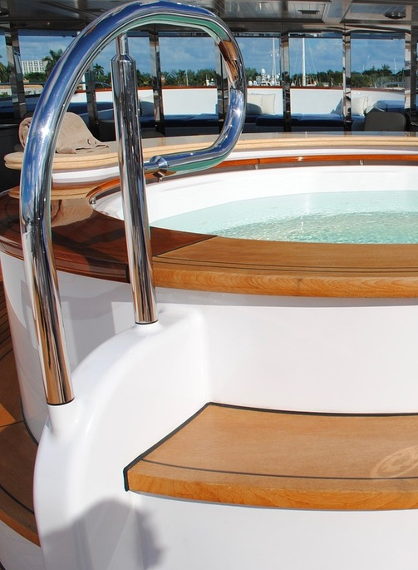

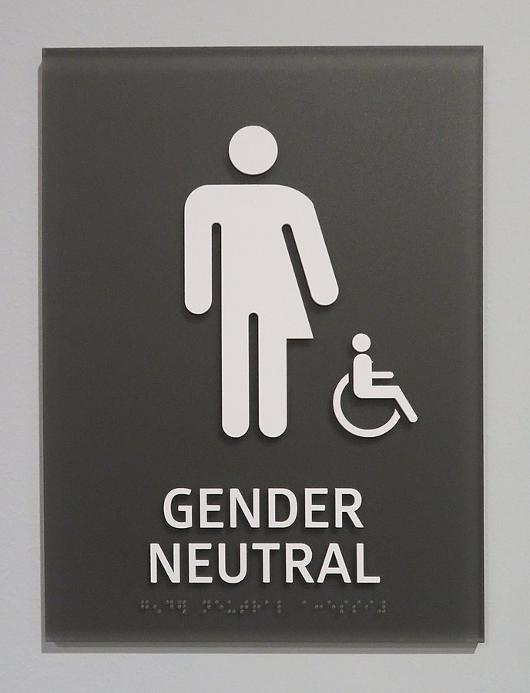
Aaqqiissutissat ilaat
Assigiinngisitaarnermut ammasuuneq
Attaveqatigiinneq
Navianassutsimik aqutsineq
Assaat naammattut aamma atortut eqqortut
MALIKE
© O'Dea at Wikimedia Commons, CC BY-SA 4.0, Papunet - KUVAKO
Notes:
From left to right:
Link to Malike webpage to introduce different tools to go to nature with people with mobility disabilities - In Finland many of the tourist hotspots have bought these tools together, bringing down the cost for individual business
Already a simple handrail makes a difference for many people, disabled, old or just tired from the days hike
Elevators help not only people on wheelchairs, but also your staff
Amount of toilets is like quality of food, if one has to queue long or feel uncomfortable in toilet, it dampens any joy from the experience. Having a selection of toilets is also important, adding few gender neutral inva-toilets supports people who’s assistant is different gender than themselves.
One of the easiest things to adjust is time. People with disabilities need more time for basic things like eating, toilet, rest in the middle of the day, but having more relaxed time-table tends to gather thanks for all participating
Openness is another easy thing to do. Not only does it make experience better for people with Tourette prone to have diverse tick-symptoms, but all of us have our own oddities
Communication is the key for good customer experience and even more so with people with disabilities. But they are also often very accustomed to explain their needs, offering important insights that support others on the way
Risk management is about making things possible while limiting the risk to acceptable level - important especially in snowy, cold environments for all activities
Saving from people and tools creates risks and exposes the service to bigger costs down the lane - injured single guide without proper First Aid kit endangering the whole group, be there people with disabilities or not

Slide 11
Qanoq?
Inuit Innarluutillit aperikkit
Tilioq
European Network for Accessible Tourism: https://www.accessibletourism.org/
A.P. Møller Fonden
Other funding options (in Kemp & Kjær webpage)
Notes:
Good way to start the change is for example to gather a pool of experts from people with disablities (and others facing other barriers) to help in planning and giving feedback on the tourism services.
There’s also a lot of knowledge out there, for example through Tilioq or ENAT

Slide 12
Qujanaq
Kalle Ristikartano
Tel. +358 40 554 1091
Email: kalle.ristikartano@iki.fi

