Slide 1
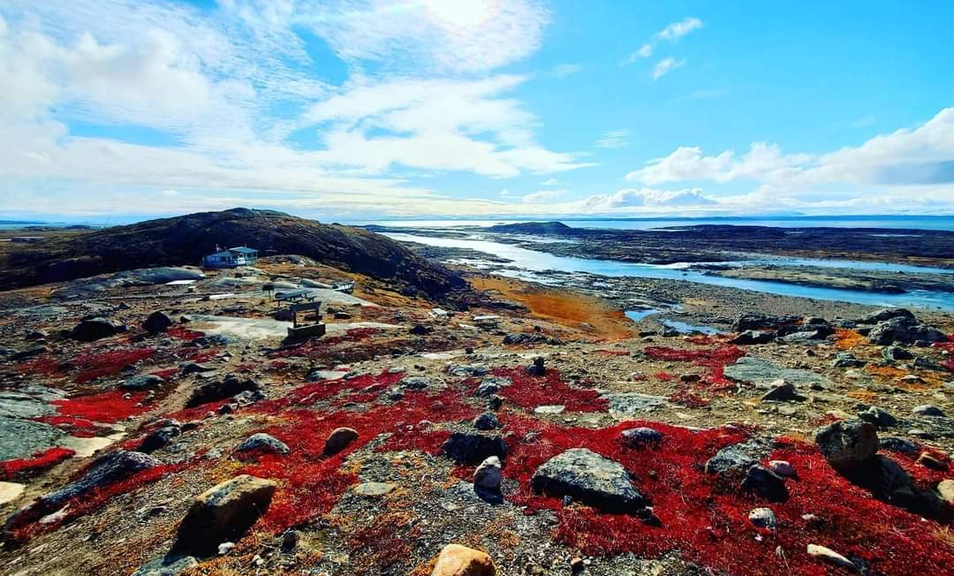

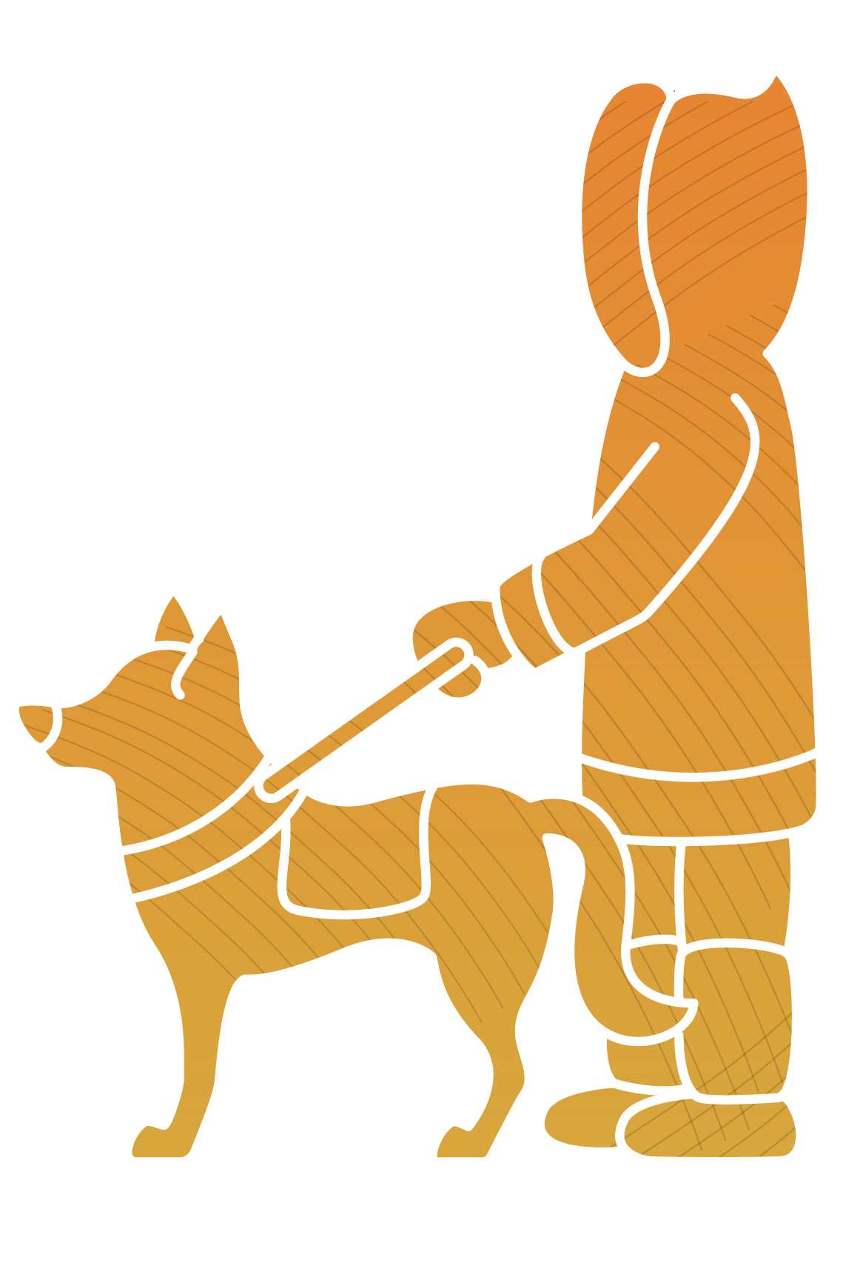
Presented by: Pierre Essoh
Operations Director

Slide 2
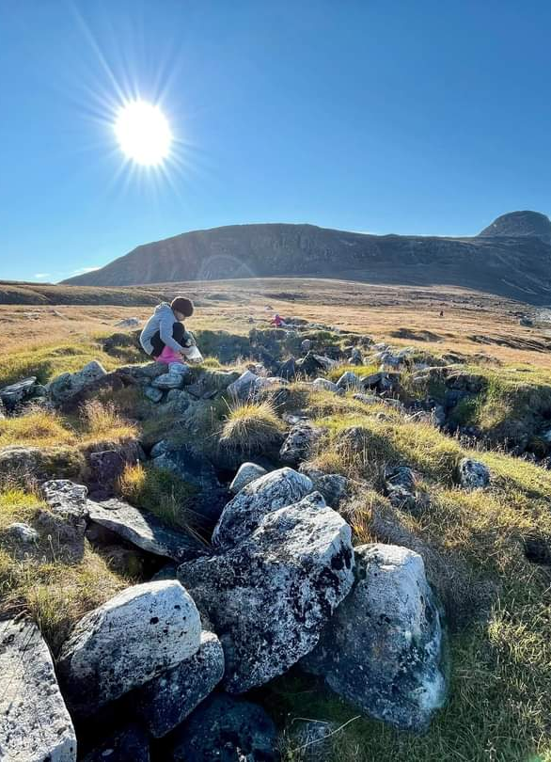
NDMS OBJECTIVE
To ensure that accessibility to basic needs, the right to accommodation, and the full inclusion of persons with disabilities for social and economic participation in their communities become a reality, as the only territorial organization for the defense of the rights of persons with disabilities.
Image: person in a field, kneeling down. Lots of grass and rocks, and the sun is shining bright.

Slide 3
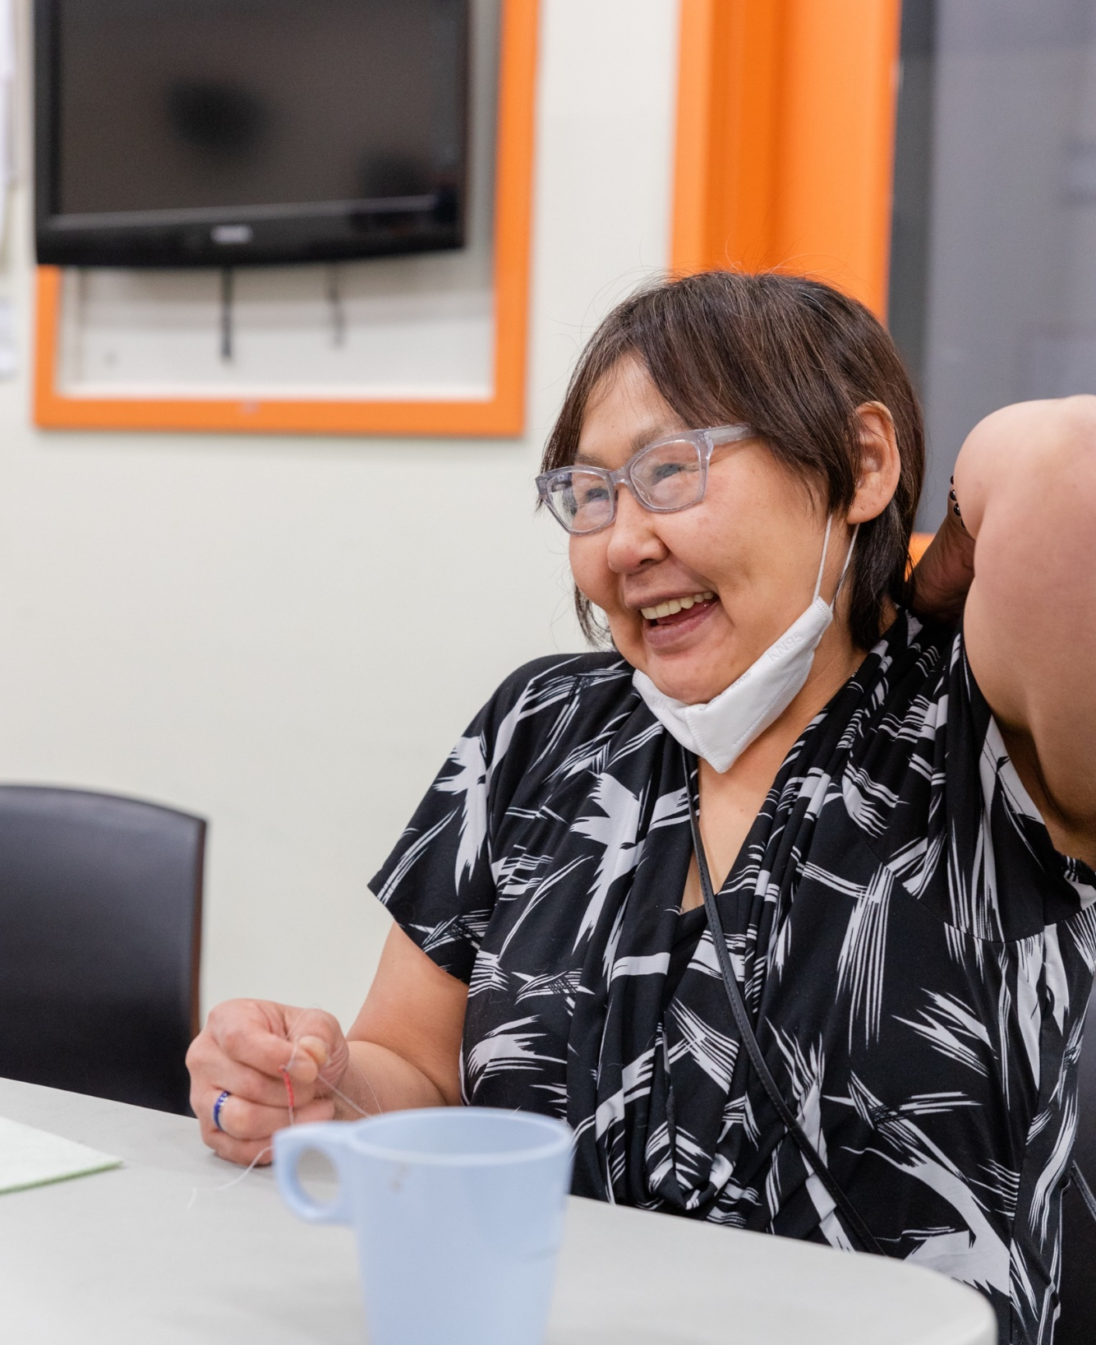



PIQATAUGITSI: INCLUSIVE EMPLOYMENT
Meaning: everyone is welcome, belongs and has meaningful contributions to make.
The Nunavut Human Rights Act (2003) purpose is “to acknowledge within the framework of Inuit Qaujimajatuqangit that the government… and all persons in Nunavut have a responsibility to guarantee that every individual in Nunavut is afforded an equal opportunity to enjoy a full and productive life and failure to provide equality of opportunity threatens the development and well-being of all persons in the community”
Inclusive employment means equitable access and sustainable employment opportunities for people with disabilities
Image: person wearing glasses and black and white shirt, smiling.

Slide 4
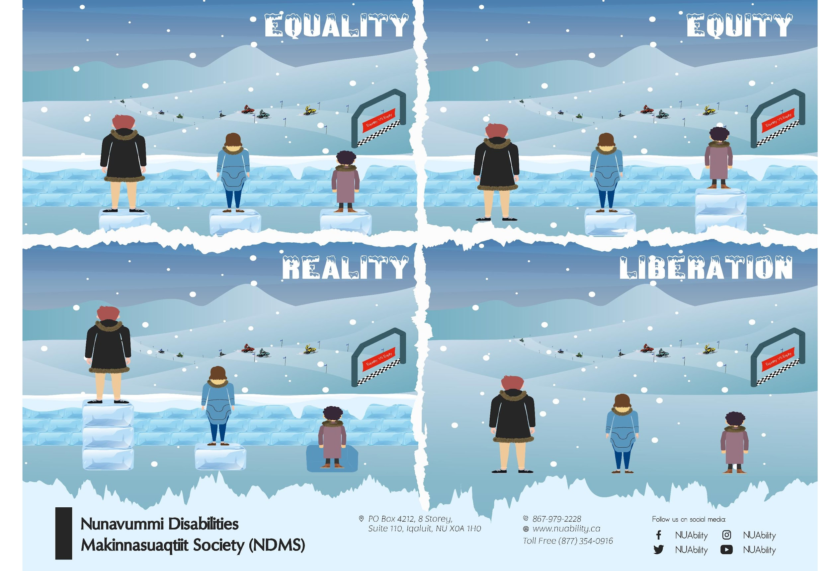
HOW CAN WE IMPLEMENT INCLUSIVE PRACTICES?
Employer engagement
Promotion of inclusive employment
Accommodating persons with disabilities
Inclusive employment Promotes:
Individual Goals
Family Wellbeing
Employer Competencies
Community Wellbeing
Economic Growth
https://www.youtube.com/watch?v=Bh0FpHJkcOo

Slide 5
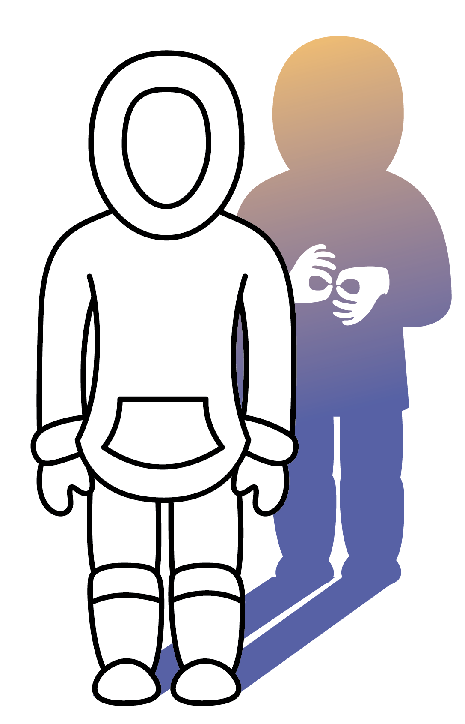
JOB COACH/MENTORSHIP PROGRAM
To increase employment opportunities and enhance sustainability
To enhance workplace learning opportunities
To provide support to employees who require additional on the-job support
We do this by:
1/ Providing training to internal or external job coach/mentor
2/ Identifying employees who need support for training or assistive devices
3/ Providing funding to pay the job coach/mentor and assistive devices

Slide 6
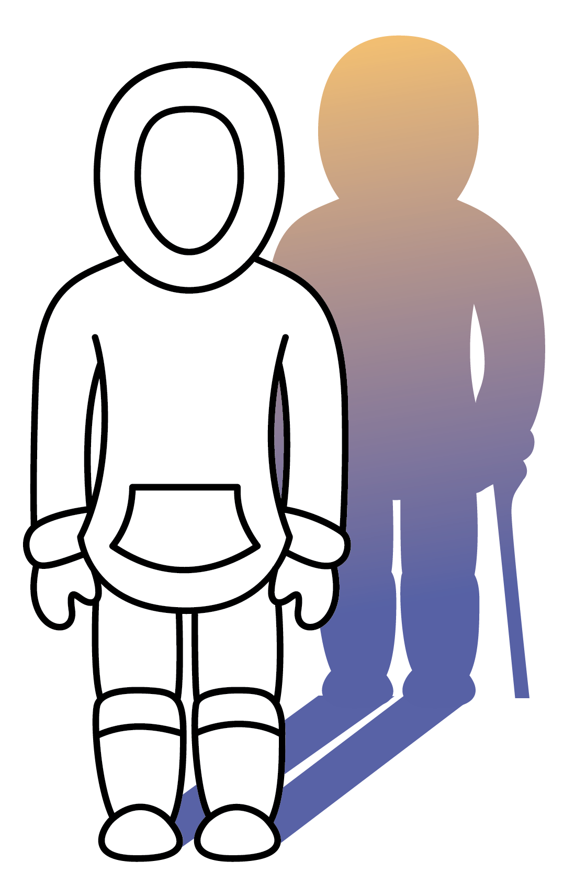
RESEARCH PROJECT: ACCESSIBILITY STANDARDS AND INUIT SOCIETAL VALUES
The first step of this research was a literature review. The review focused on the following questions: What kind of accessibility and disability frameworks are meaningful for Nunavut communities and government?
In the second part, the research team travelled through Nunavut's 25 communities. Used sharing circles to reach out to the disability community and service providers to get their opinions on accessibility. So far, we have interviewed nearly 400 people. 20 communities have already been visited.
Phase 3, data analysis, currently underway.

Slide 7
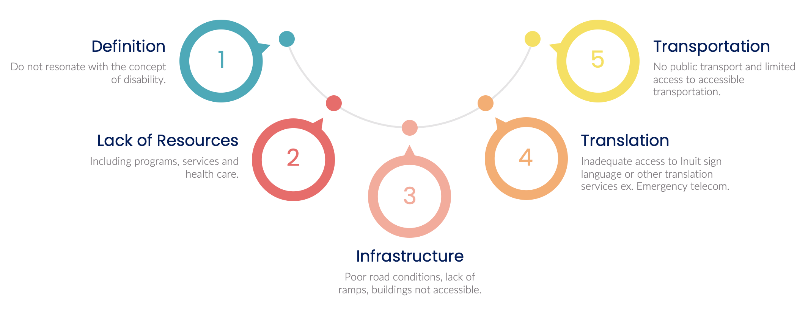
RESEARCH FINDINGS TO DATE

Slide 8
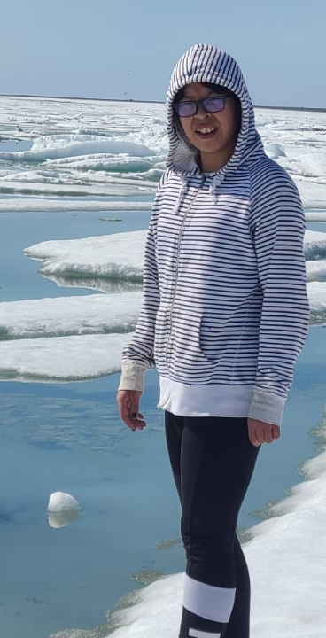
SOLUTIONS FOR A MORE INCLUSIVE SOCIETY & WORKFORCE FOR PEOPLE WITH DISABILITIES
Focusing on individual needs instead of government priorities. While we meet project objectives, we do so in a way that supports disabled Nunavummiut
Sharing knowledge with communities, governments, businesses and individuals at all levels
Empower disability organisations and disabled communities by giving them directly the resources (they are the expert of their needs)
Participating in national coalitions, policy panels and community of practices
Pushing back on tokenistic invitations for participation, especially in relation to disability representation amongst Indigenous people
Image: person wearing a white and black striped hoodie with glasses, standing on sea ice.

Slide 9
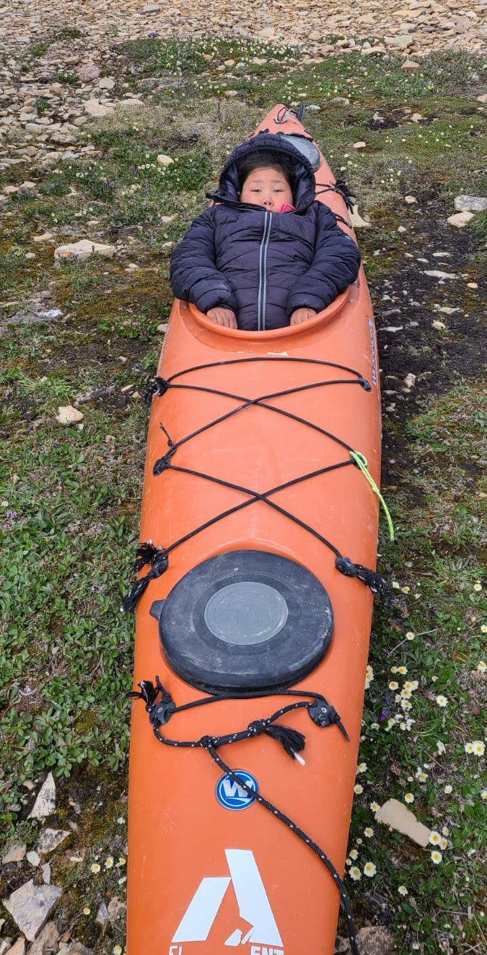
SOLUTIONS FOR INCLUSION CONTINUED…
Developing course material that is culturally relevant and includes Inuit Societal Norms
Engage employer on inclusive hiring policy
Allowing individuals to drive learning, but also recognizing that employment is influenced by so many other variables including housing, poverty and so on. We offer programs that help individuals with living expenses, food and so on.
Job coaches are fundamental to support holistic and wrap around supports
Provide services before diagnosis
VIDEO ON INCLUSIVE HIRING:
https://www.youtube.com/watch?v=4cjb3_DSyjg
Image: person wearing a white and black striped hoodie with glasses, standing on sea ice.

Slide 10
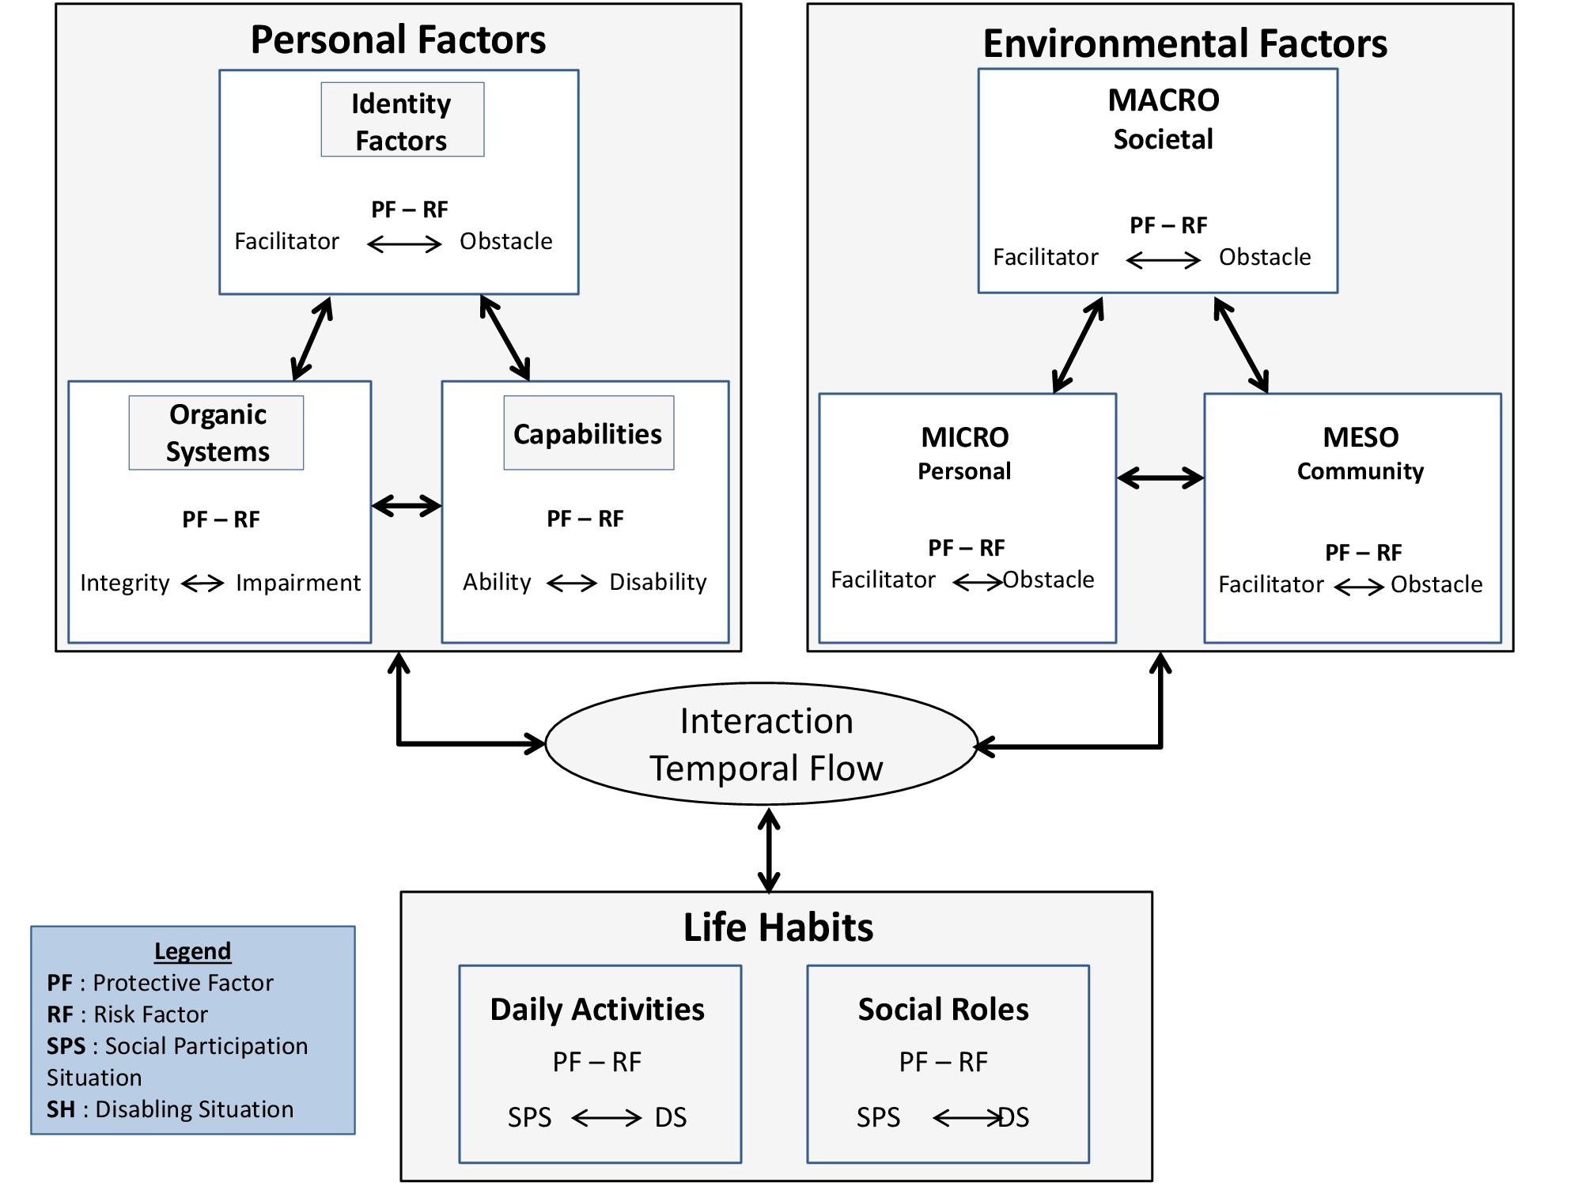
The needs of people with disabilities according Human Development Model – Disability Creation Process (HDM-DCP)
The total accomplishment of life habits, resulting from the interaction between personal factors (impairments, disabilities and other personal characteristics) and environmental factors (facilitators and obstacles)
(Conceptual framework of the Quebec Classification, HDM- DCP to the social participation, Fourgeyrollas, P. et al., 2010)

Slide 11

Thank you! Quanamy!
Nakurmiik! Merci!

Slide 12
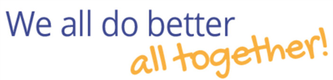
Contact Us
  Website: www.nuability.ca
  Email: connect@nuability.ca
  Phone: Toll-free 877.354.0916 or 1.867.979.2228

